Slide 1


Subject Name :MICROPROCESSOR ANDMICROCONTROLLER Presentation Title: ARM 7 MICROPROCESSOR
JEPPIAAR INSTITUTE OF TECHNOLOGY
“Self-Belief | Self Discipline | Self Respect”
Department of Electronics and Communication Engineering
Team Members:
Students Name Reg.No:
PREETHA.S 210617106062
GOPIKA C.A 210617106033
BALA KUMAR .A 210617106015
BHARATH KUMAR.S 210617106017
KARTHIK.G 210617106046
VENKATESH.J 210617106083

Slide 2
TECHNICAL DETAILS
The ARM-7was originally developed at Acorn computers limited of Cambridge.
The ARM-7 Based LPC2148 Microcontroller Architecture
The ARM7 is a 32-bit general purpose microprocessor

Slide 3
ARCHITECTURE OF ARM-7
Arm processor consists of:
One booth multiplier
Arithmetic and logic unit
barrel shifter
One control unit
One register file
Program register
Instruction register
Priority encoder

Slide 4
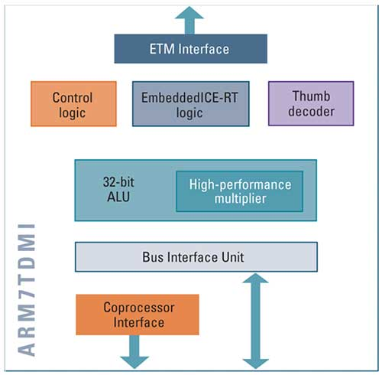
ARM-7 architecture

Slide 5

working
ARM-7 has three stage pipeling process
Fetch – instruction is fetched from memory and placed in pipeline;
Decode – instruction is decoded and data-path signals prepared for next cycle;
Execute – instruction from prepared data-path reads from registry bank, shifts operand to ALU and writes generated result to dominant register.

Slide 6
ADVANTAGES
They are cheap as compared to other processors.
They are designed with such features that it consumes less power.
The devices with ARM processor can have a much better battery life than other processors.
They perform one operation at a time and thus work faster.

Slide 7
Disadvantages
It is not binary compatible with x86, which means you cannot run windows on it very soon.
Some ARM processors clock frequencies, which is why speeds and memory bandwidths are limited in such cases.
The scheduling of instructions makes debugging difficult.

Slide 8
Conclusion
ARM 7 OFFER a distinct advantage over intel x86.
Provides benefits in the wide range of technology design and development such as embedded as real time application automotive control system ,portable application and secure application .

Slide 9
Scope and application
Mobile phones and PDA
Patient monitoring
Automotive power train
Anti lock braking
High end washing machine
Image processing

Slide 10
Reference
ARM7 Family Webpage; ARM Holdings.
"ARM7DI Data Sheet"; Document Number ARM DDI 0027D; Issued: December 1994.
Sharif. "ARM co-founder John Biggs". Engadget. Retrieved 23 December 2011. [...] the ARM7-TDMI was licensed by Texas Instruments and designed into the Nokia 6110, which was the first ARM-powered GSM phone.
Walshe, Ben (13 March 2018). "A look at devices that have shaped mobile gaming". Arm Community. Retrieved 12 September 2019
"Remembering the Sega Dreamcast". 29 September 2009.

Slide 11
THANK YOU!

